Slide 1
Solving Hamiltonian Constraint Equation with Physics Informed Neural Operators
Hilary Wu
Y.-C. Zhou et al., “Solving Hamiltonian Constraint Equation with Physics-Informed Neural Networks,” Phys. Rev. D, Jun. 2026, doi: 10.1103/619s-p6md.
Z. Li et al., “Physics-Informed Neural Operator for Learning Partial Differential Equations,” Jul. 29, 2023, arXiv: arXiv:2111.03794. doi: 10.48550/arXiv.2111.03794.
G. B. Cook, “Initial Data for Numerical Relativity,” Living Rev. Relativ., vol. 3, no. 1, p. 5, Dec. 2000, doi: 10.12942/lrr-2000-5.

Slide 2
Background
Processing of gravitational wave data detected on Earth requires accurate snapshot of initial gravitational field data
Focusing on non-spinning binary blackhole (BBH) systems
Traditional numerical relativity (NR) techniques to examine compact binary object coalescence (CBC) are computationally expensive
ML methods can be more computationally efficient

Slide 3
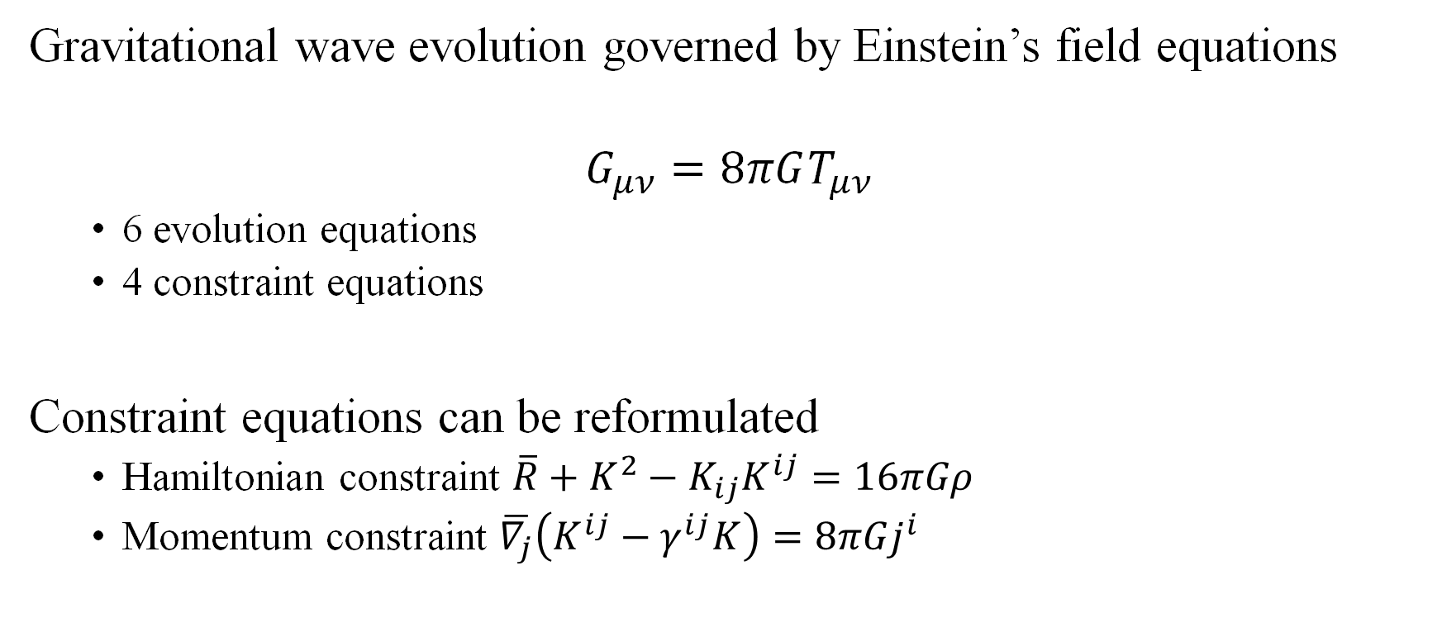
Theory (1)
Gravitational wave evolution governed by Einstein’s field equations
$$G_{μν}=8πGT_{μν}$$
6 evolution equations
4 constraint equations
Constraint equations can be reformulated
Hamiltonian constraint $\overline{R}+K^{2}−K_{ij}K^{ij}=16πGρ$
Momentum constraint $\overline{∇_{j}}\left(K^{ij}−γ^{ij}K\right)=8πGj^{i}$

Slide 4

Theory (2)
Lichnerowicz-York Conformal Method
$$Δψ+\frac{1}{8}ψ^{−7}{\overline{K}}_{ij}{\overline{K}}^{ij}=0$$
Decomposing conformal factor $ψ$
$$ψ=1+\sum_{n}{\frac{m_{n}}{2r_{n}}}+u$$
$$Δu+\frac{1}{8}{\left(1+\sum_{n}{\frac{m_{n}}{2r_{n}}}+u\right)}^{−7}{\overline{K}}_{ij}{\overline{K}}^{ij}=0$$

Slide 5
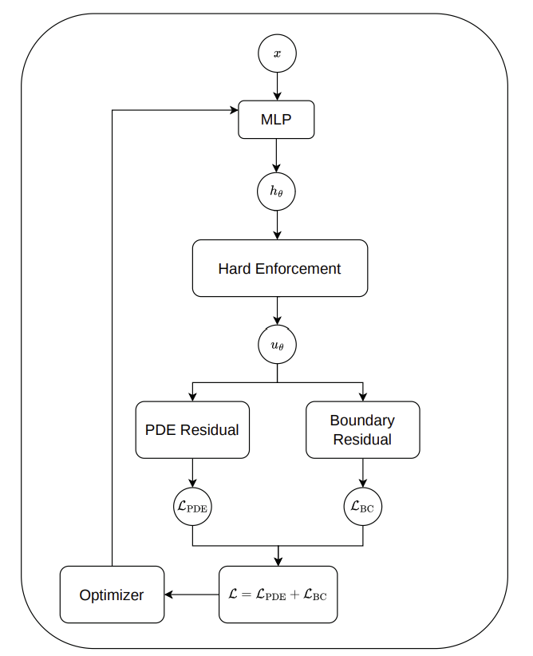

Zhou et. al (PINN)
MLP architecture:
3 hidden layers (64 neurons each)
SiLU activation function
Adam optimizer $\text{lr}=3×{10}^{−4}$
5000 epochs
Guided hard-enforcement ansatz:
$$u_{θ}\left(x\right)=κu_{g}\left(x\right)\left[1+cW\left(x\right)\tanh\left(h_{θ}\left(x\right)\right)\right]$$
$$ℒ_{PDE}=w_{2}L_{2}+w_{∞}\text{soft}-L_{∞}$$
$$ℒ_{BC}=w_{rob}\frac{1}{N_{dΩ}}\sum_{i=1}^{N_{dΩ}}{ℛ_{B,i}^{2}}$$

Slide 6
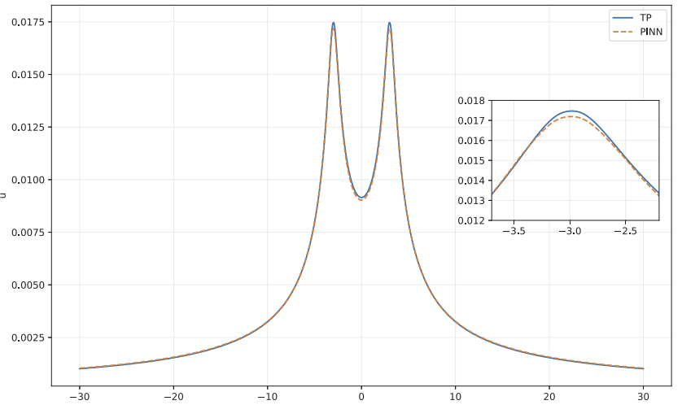
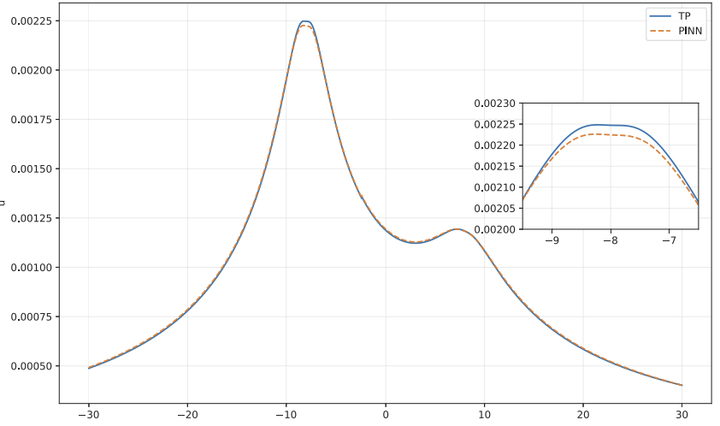


Results
$$\text{L}\text{2}\text{RE}=0.0172±0.0040$$
$$\text{L}\text{2}\text{RE}=0.0077±0.0007$$

Slide 7
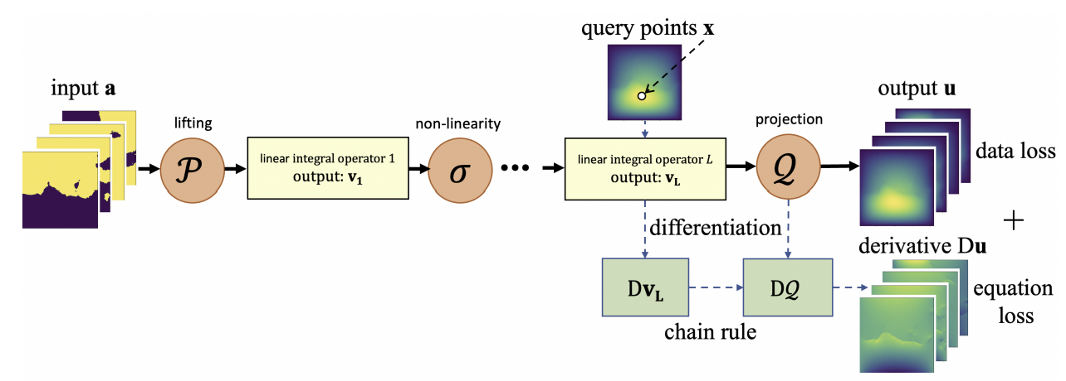
Project Proposal (1)
Train a Physics Informed Neural Operator (PINO) to generate initial data for non-spinning BBH systems
PINO = FNO + PINN

Slide 8
Project Proposal (2)
Parameterise relative masses of the blackholes
Use same ansatz and loss functions developed by Zhou et. al
Train on data generated from TwoPunctures program
Predict gravitational field correction for unseen relative masses
Setup:
Based on simple non-spinning equal-mass BBH system in Zhou et. al paper
Blackholes 6 units of space apart orbiting centre of mass (CoM)
Momentum of the blackholes scaled by relative masses

Slide 9
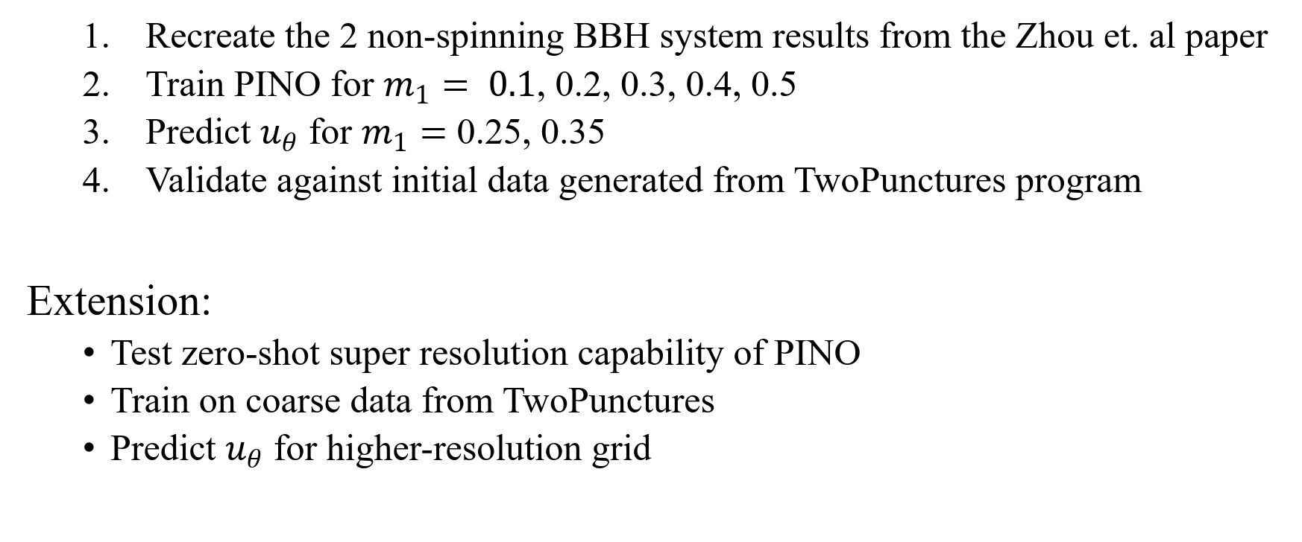
Project Plan
Recreate the 2 non-spinning BBH system results from the Zhou et. al paper
Train PINO for $m_{1}= 0.1$, 0.2, 0.3, 0.4, 0.5
Predict $u_{θ}$ for $m_{1}=$ 0.25, 0.35
Validate against initial data generated from TwoPunctures program
Extension:
Test zero-shot super resolution capability of PINO
Train on coarse data from TwoPunctures
Predict $u_{θ}$ for higher-resolution grid

Slide 10
Thank you for listening
Suggestions?

